Slide 1

CAPSTONE PROJECT
Text Generation Using RNN
Final Project
Presented By
Mani D
711721244032
III Btech CSBS
KGiSL Institute of Technology
3/21/2024 Annual Review
1

Slide 2

PROJECT TITLE
Text Generation Using RNN
3/21/2024 Annual Review
2

Slide 3



AGENDA
1. Problem Statement
2. Project Overview
3. End Users
4. Solution and Value Proposition
5. The Wow Factor in Your Solution
6. Modelling
7. Results
3
3/21/2024 Annual Review

Slide 4

PROBLEM STATEMENT
Build an RNN-based text generation model to produce text that makes sense and is relevant to the given context.
Take on the challenge of writing prose that has the same fluency and semantic coherence as human language.
Use a large corpus of text data to teach the model the intricate patterns and structures seen in natural language.
3/21/2024 Annual Review
4

Slide 5

PROJECT OVERVIEW
Develop a text generation system that leverages Recurrent Neural Networks (RNNs) to overcome challenges in producing coherent and contextually relevant information, hence addressing inadequacies in existing methods.
RNN architecture can be used to manage sequential data and extract intricate language patterns. Train the model on a range of text corpora using preprocessing techniques to maximize learning.
Create an advanced text generation model that can generate text that resembles human writing. Natural language processing will progress as a result, and personalized chatbots, content production, and writing assistance could all benefit from this.
3/21/2024 Annual Review
5

Slide 6

WHO ARE THE END USERS?
Our temperature forecasting model caters to diverse industries such as agriculture, events, energy, emergency response, and urban planning.
Stakeholders include farmers, event organizers, energy providers, emergency responders, and urban planners, who rely on accurate temperature predictions for decision-making and risk management.
3/21/2024 Annual Review
6

Slide 7

YOUR SOLUTION AND ITS VALUE PROPOSITION
With the help of our Recurrent Neural Network (RNN)-powered text production technology, users may easily and quickly produce quality writing while streamlining content development methods.
The method ensures that the content meets professional writing standards and effectively communicates the desired message by producing coherent and contextually appropriate prose.
Our solution meets a variety of user needs, such as content creation, chatbot development, and assistance with creative writing, and provides critical support in various domains of natural language processing.
3/21/2024 Annual Review
7

Slide 8

THE WOW IN YOUR SOLUTION
Our method produces text that is as coherent and fluid as human-generated stuff.
Users can generate high-quality writing quickly, which speeds up their content production processes and saves them valuable time.
Our system has applications across industries and areas and may be used for a wide range of user needs, from content creation to chatbot development.
Our technology is driven by state-of-the-art Recurrent Neural Networks (RNNs) and provides customers with incomparable results while showcasing the newest advancements in natural language processing.
3/21/2024 Annual Review
8

Slide 9
MODELLING
In RNN architecture, sequential dependencies in text data are captured by recurrent neural networks (RNNs), which enables the production of coherent text.
Dense word embeddings, which capture the semantic relationships between words, are utilized to enhance the model's language comprehension.
To predict the next word in a sequence, the model is trained on multiple text corpora. The text production abilities of the model are enhanced by iterative learning.
The utilization of regularization strategies and hyperparameter modifications optimizes model performance and ensures dependable, superior text generation.
3/21/2024 Annual Review
9

Slide 10
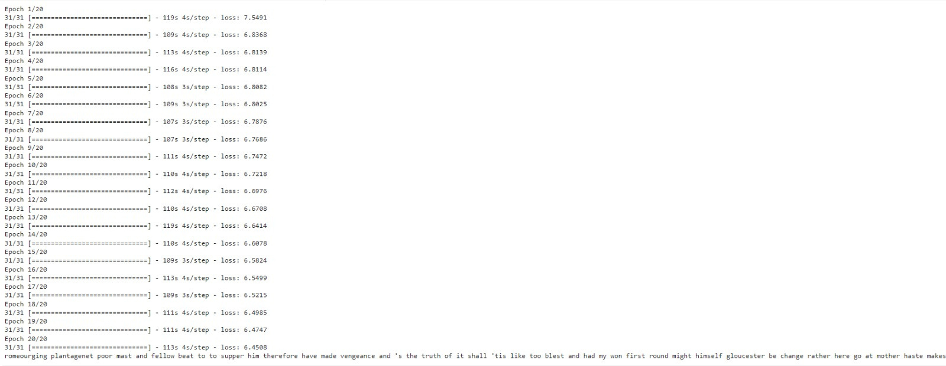
RESULTS
Demo Link
3/21/2024 Annual Review
10

